Slide 1

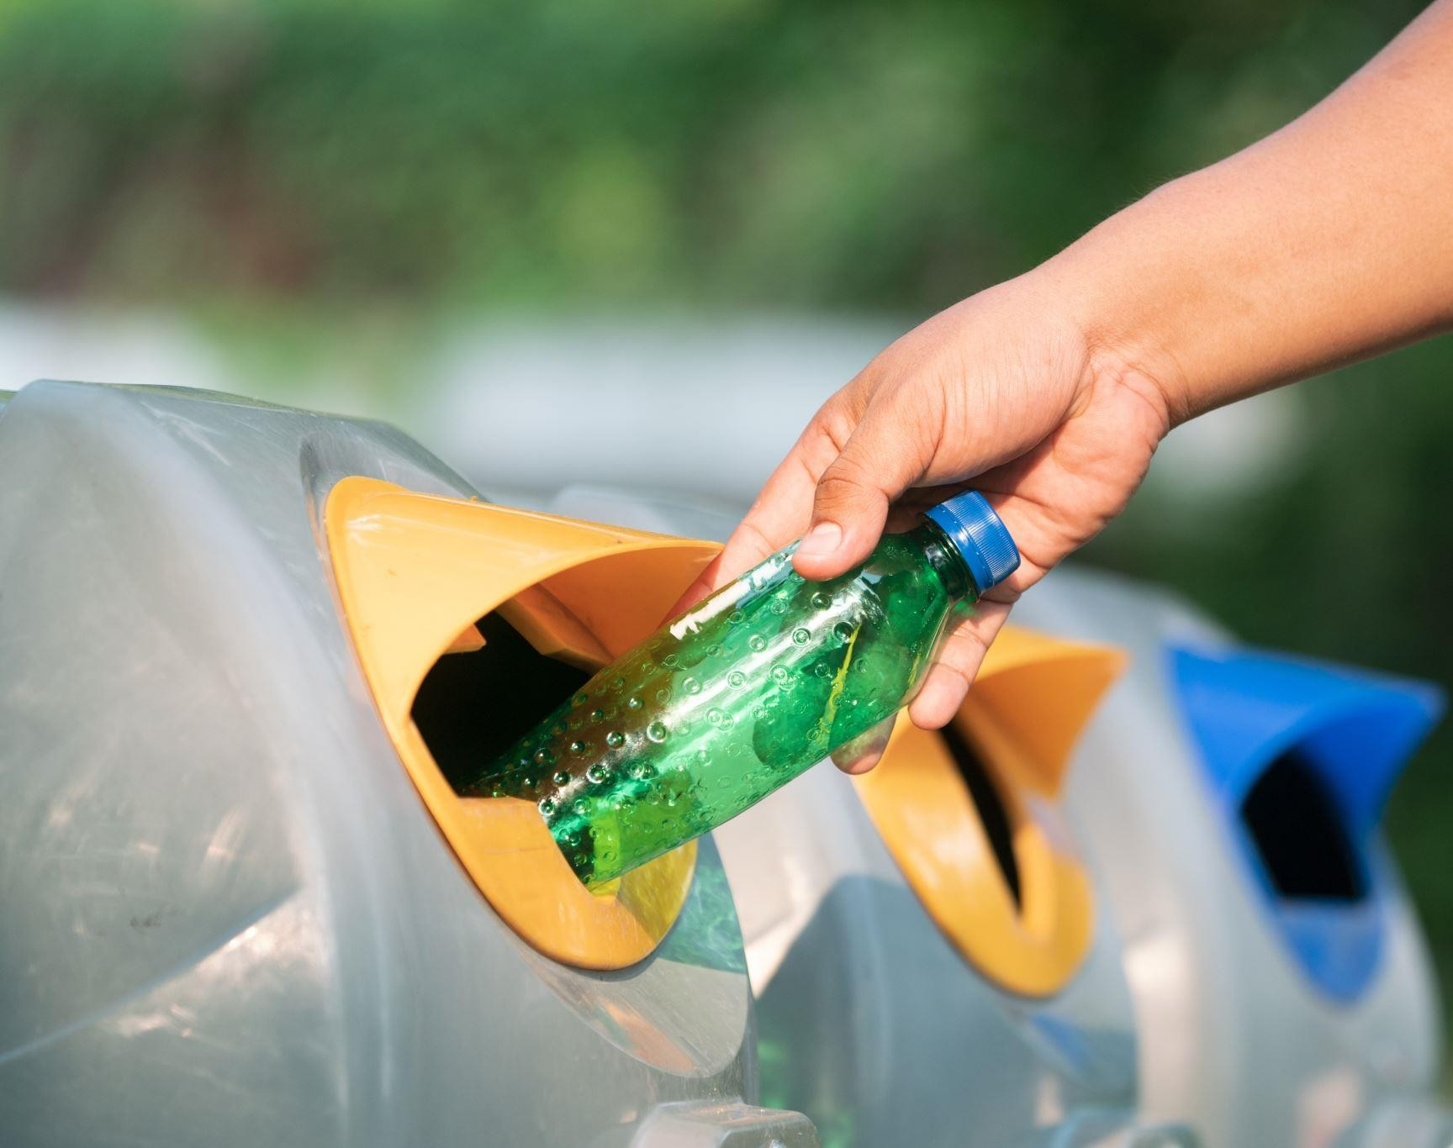
Smart City Waste Management
Team members:
Maha Laxmi Prathapaneni Bhanu Prakash Chennupati Nandan Ankireddy

Slide 2

Problem Statement
Leads to environmental issues and higher operational costs
Inefficient waste management in smart cities
Hinders optimization of waste management
Solution: Utilize Machine Learning for data analytics

Slide 3


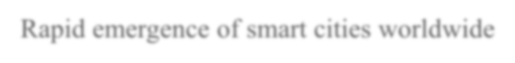



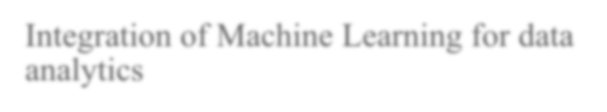
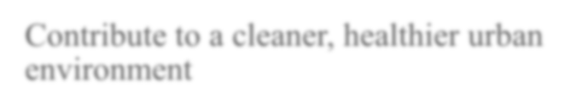
Business Need
Rapid emergence of smart cities worldwide
Rapid emergence of smart cities worldwide Rapid emergence of smart cities worldwide
Integration of Machine Learning for data analytics
Contribute to a cleaner, healthier urban environment

Slide 4




Requirement: Importance of
efficient waste management
Gap in Solutions: Growing global adoption of smart city initiatives
Success Stories: Success stories in technology and data analytics
Solutions: Need for tailored solutions

Slide 5







Data collection and integration
Waste Management MVP Components:
IoT sensors on waste bins, weather data, historical waste collection data
Backend component: Integrated dataset
Machine learning algorithms for route and schedule
optimization

Slide 6






Minimum Viable Product (MVP)
Data ingestion from IoT sensors, weather data, and historical data
Machine Learning for Optimization: Using algorithms for
efficient resource allocation.
User-friendly dashboard for waste management personnel
Visualization Tools: Assisting city waste management administrators.
Data storage and security:
Integration with existing smart city infrastructure

Slide 7
High Level Architecture
This project's goal is to significantly improve waste management in smart cities, reduce operational costs, and contribute to a cleaner and more sustainable urban environment, while using Machine Learning for data visualization and analytics to enhance decision-making and user engagement.

Slide 8
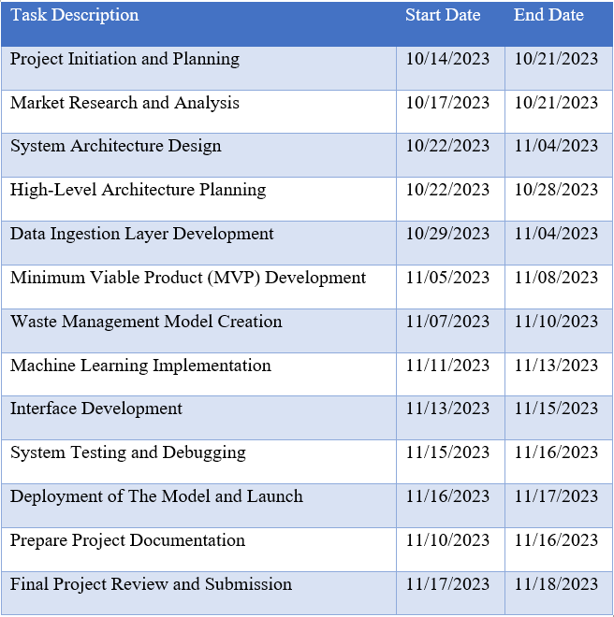
Project Timeline:

Slide 9

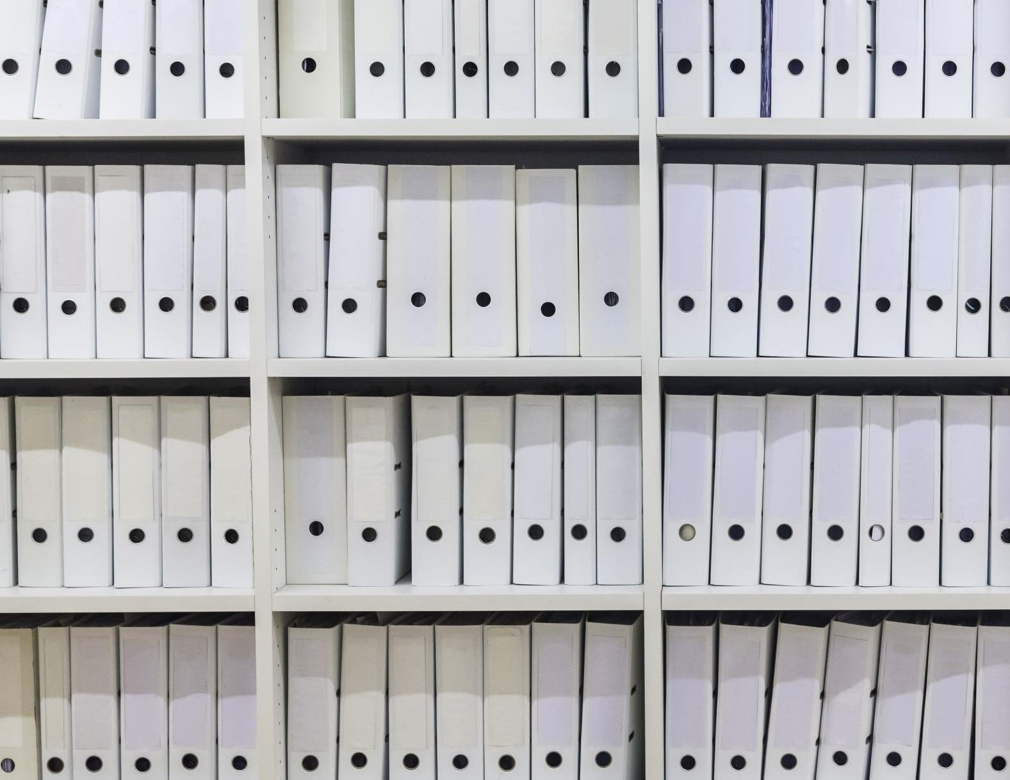
REFERENCES
Hasan, M. K., Khan, M. A., Issa, G. F., Atta, A., Akram, A. S., & Hassan, M. (2022, February). Smart waste management and classification system for smart cities using deep learning.
In 2022 International Conference on Business Analytics for Technology and Security (ICBATS) (pp. 1-7). IEEE. https://ieeexplore.ieee.org/abstract/document/9759087/
Sharma, M., Joshi, S., Kannan, D., Govindan, K., Singh, R., & Purohit, H. C. (2020). Internet of Things (IoT) adoption barriers of smart cities’ waste management: An Indian context. Journal of Cleaner Production, 270, 122047. https://www.sciencedirect.com/science/article/pii/S095965262 0320941
Vishnu, S., Ramson, S. J., Senith, S., Anagnostopoulos, T., Abu-Mahfouz, A. M., Fan, X., ... & Kirubaraj, A. A. (2021). IoT-Enabled solid waste management in smart cities. Smart Cities, 4(3), 1004-1017. https://www.mdpi.com/2624- 6511/4/3/53
Datasets Link: https://www.kaggle.com/datasets/techsash/waste-classification-data

